Slide 1
NLP Week7

Slide 2
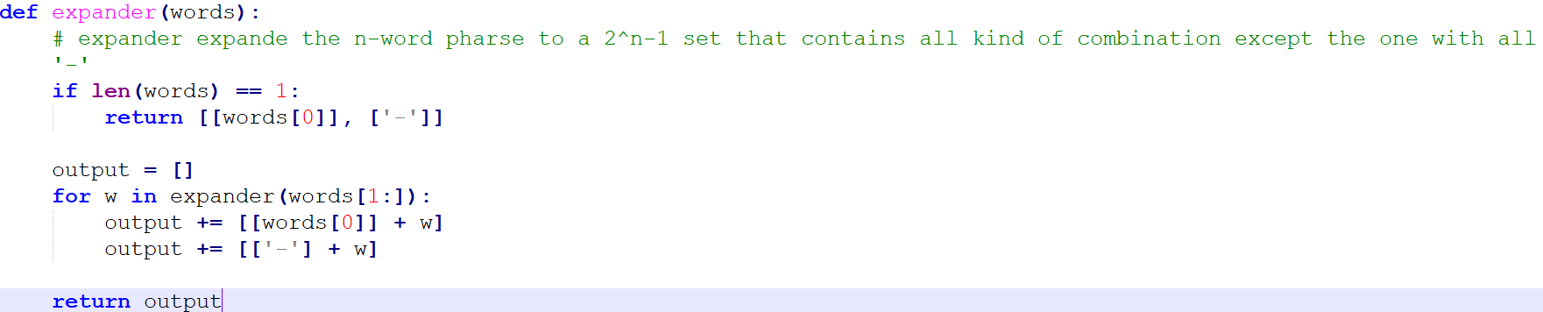
Mapper

Slide 3
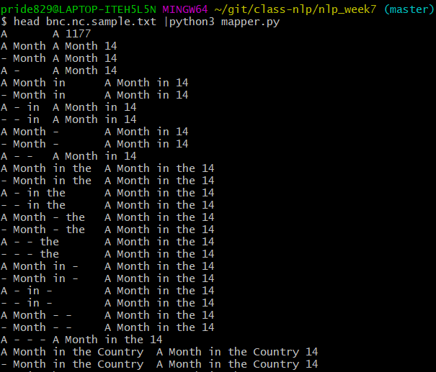

Slide 4
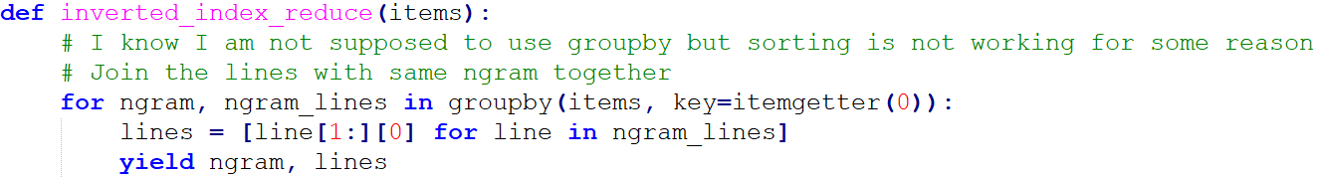

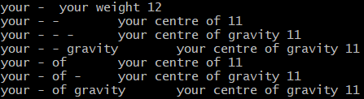
Reducer

Slide 5
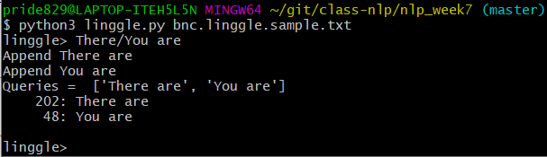
Linggle
All symbols are parsed and added to the original queries.
Parse the queries until there are no symbols left.

Slide 6
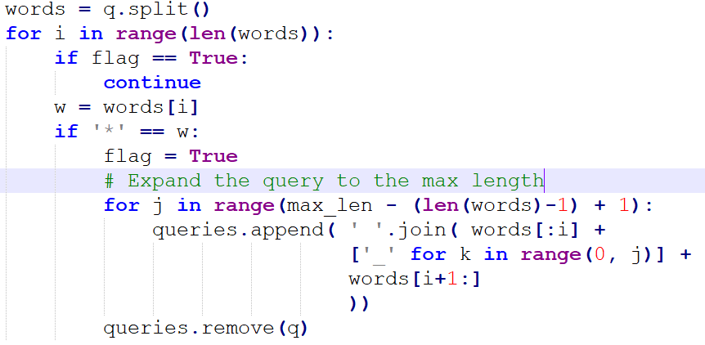
Linggle - *
Calculate the max-length of phrases and expand the queries.

Slide 7
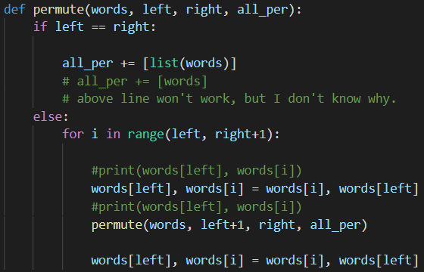

Linggle – {}
Use recursion to list all permutation of given words.

Slide 8
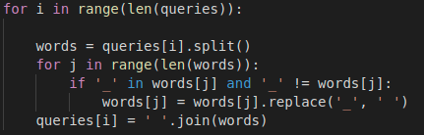

Linggle – _
Simply replace all _ at the end.

Slide 9
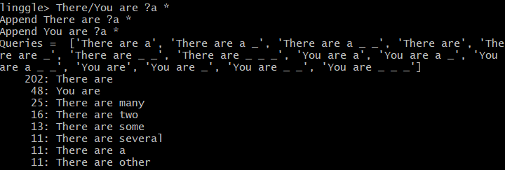
Linggle
Multiple symbols in one sentence supported!

Slide 10
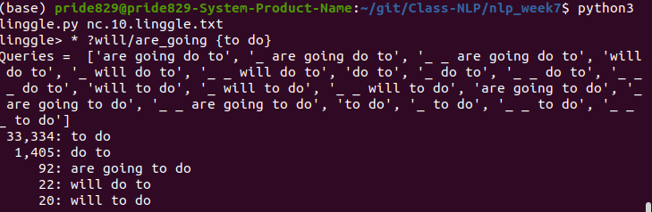
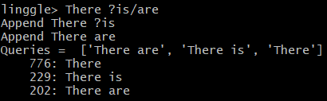
Linggle
Multiple symbol in one word supported (in limited situation)!
{} can’t be mixed with ? or /

